Slide 1

Shop Management System By: Shreyas Ganesh – PES2UG19CS387 Saurabh Yadav – PES2UG19CS371 Satwik Bansal – PES2UG19CS470 Sapna Singh – PES2UG19CS366 6th Semester Section F

Slide 2
TABLE OF CONTENTS
1. Project Description
a. Link to Github repository
2. Analysis and Design Models
3. Tools and Frameworks Used
4. Design Principles and Design Patterns Applied
5. Application Screenshots
6. Conclusion
7. References

Slide 3

PROJECT DESCRIPTION
Creating a shop management system to help with the efficient functioning of the shop it's deployed in. It provides necessary features to help various entities. There are 3 profiles in the application: customer, shop inventory, and shopkeeper.
Customers and shopkeepers are for smoothing transactions.
Shop inventory profile would help keep track of stocks and customer demands. The inventory tracking can be used to maximize profits by identifying the most and least sold products.
The customer profile is for each individual customer to add things to the cart. Storage of cart details. Gives unique identification for each customer, and quick payment options.
Shopkeeper profile contains shop id to identify stores uniquely, transaction IDs. Details about the items sold on a particular day on his shift and details about the items sold at his store. Keeping track of transaction logs by date.
LINK TO GITHUB: https://github.com/shreyasganesh01/ShopManagement.git

Slide 4
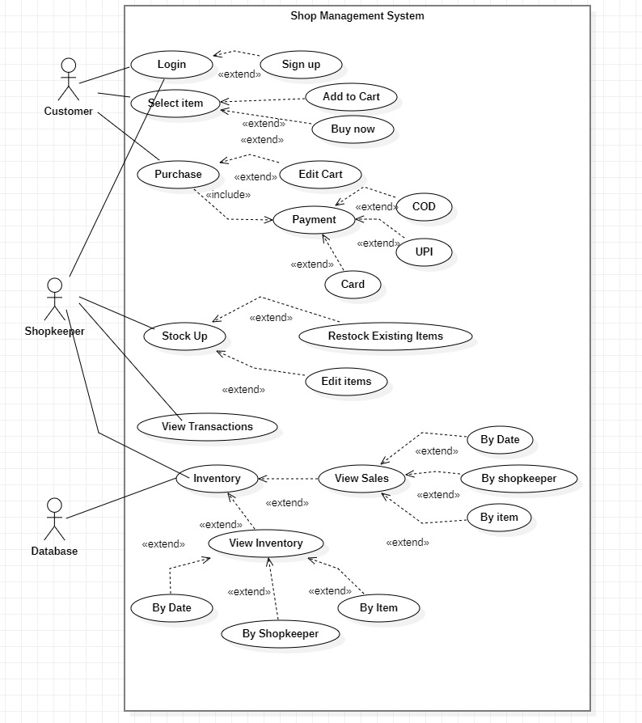
ANALYSIS AND DESIGN MODELS
USE CASE DIAGRAM:

Slide 5
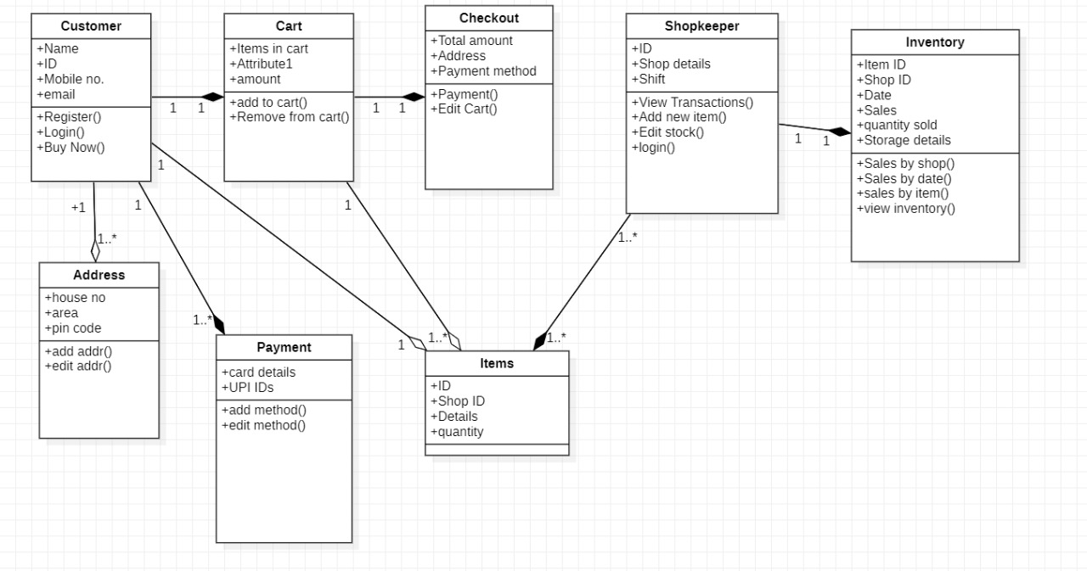
ANALYSIS AND DESIGN MODELS
CLASS DIAGRAM:

Slide 6
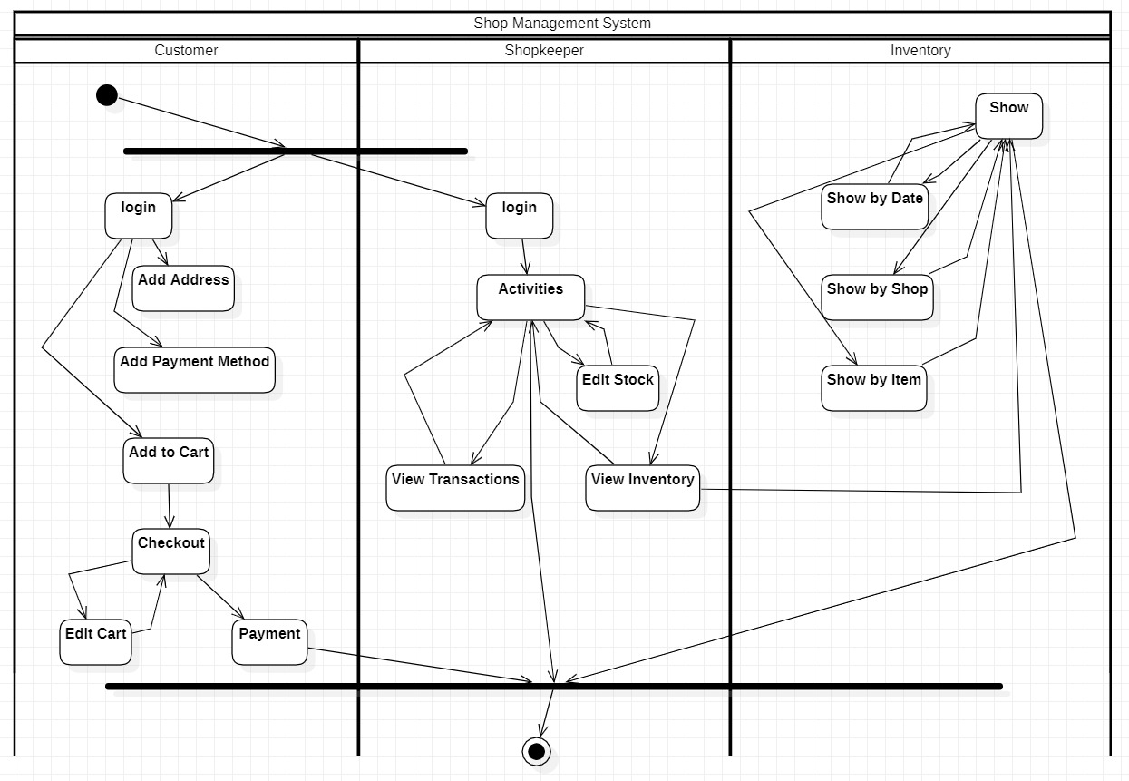
ANALYSIS AND DESIGN MODELS
ACTIVITY DIAGRAM:

Slide 7
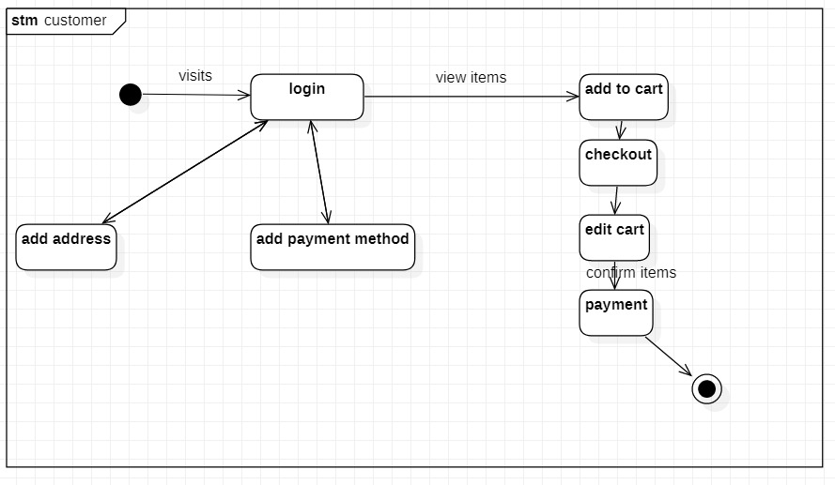
ANALYSIS AND DESIGN MODELS
STATE DIAGRAM 1:

Slide 8
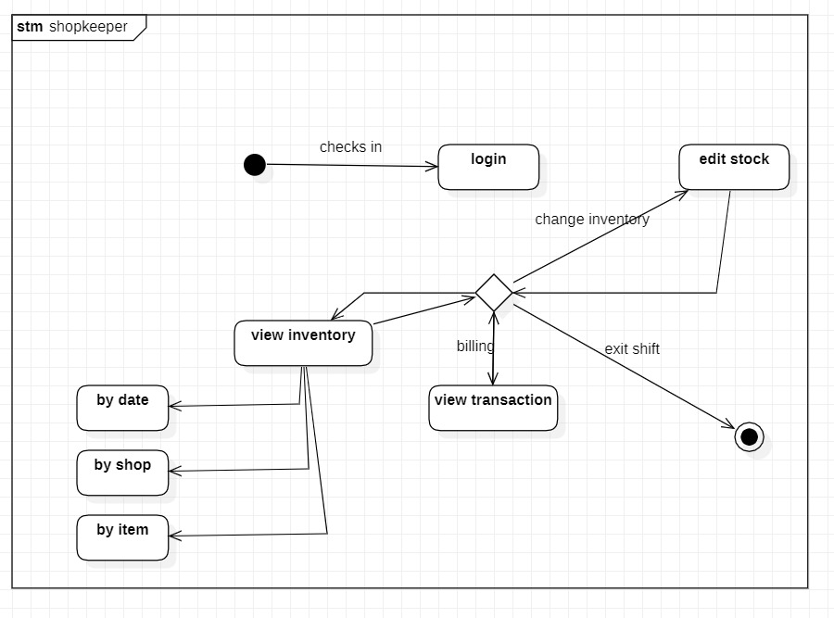
ANALYSIS AND DESIGN MODELS
STATE DIAGRAM 2:

Slide 9
TOOLS AND FRAMEWORKS USED
Java swing: Swing in java is part of the Java foundation class which is lightweight and platform-independent. It is used for creating window-based applications. It includes components like buttons, scroll bar, text fields, etc. Putting together all these components makes a graphical user interface.
Java AWT: Java AWT (Abstract Window Toolkit) is an API to develop Graphical User Interface (GUI) or windows-based applications in Java.
Java AWT components are platform-dependent i.e. components are displayed according to the view of the operating system. AWT is heavyweight i.e. its components are using the resources of the underlying operating system (OS).
Mysql: MySQL is a relational database management system based on SQL – Structured Query Language. The application is used for a wide range of purposes, including data warehousing, e-commerce, and logging applications. The most common use for MySQL however, is for the purpose of a web database.

Slide 10
DESIGN PRINCIPLES AND DESIGN PATTERNS APPLIED
The project implements a Behavioral design pattern: adapter.
An Adapter Pattern says that it just "converts the interface of a class into another interface that a client wants".
The project implements this using various activity interfaces that implement a common "ActionListener" interface which is then changed according to the activity i.e., Login, Signup, Customer, Profile Product, etc.

Slide 11
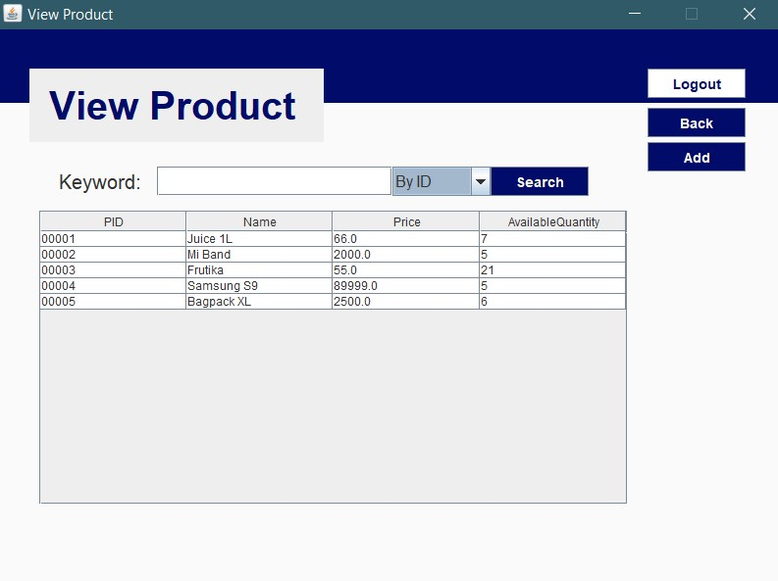
APLPICATIONS SCREENSHOTS
PRODUCT:

Slide 12
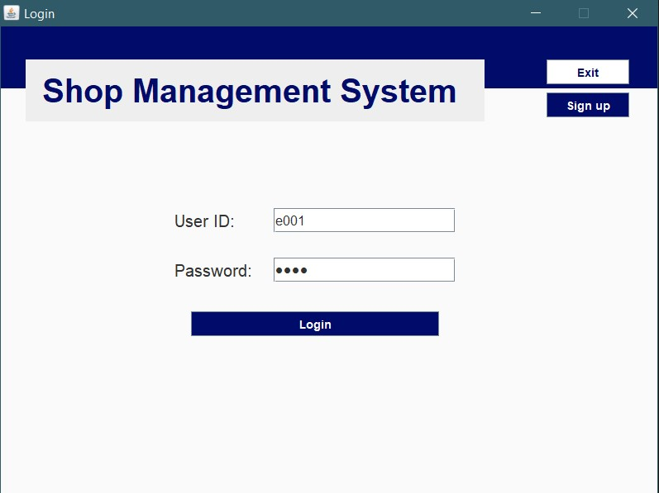
APLPICATIONS SCREENSHOTS
LOGIN PAGE:

Slide 13
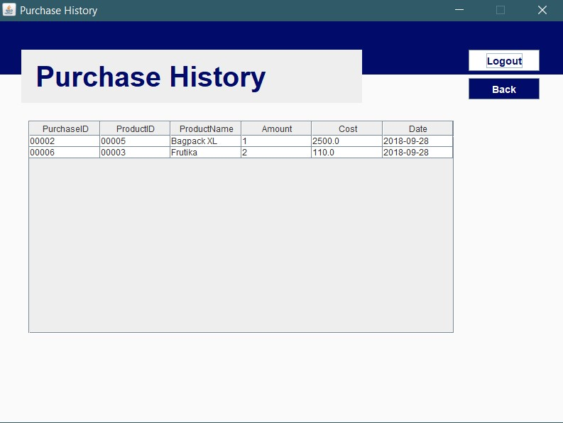
APLPICATIONS SCREENSHOTS
HISTORY:

Slide 14
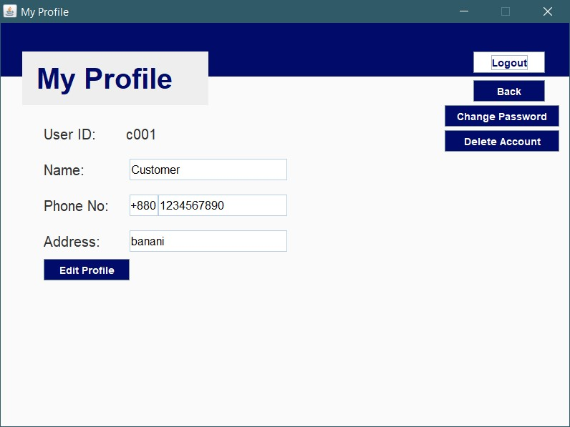
APLPICATIONS SCREENSHOTS
EDIT PROFILE:

Slide 15
CONCLUSIONS
The shop management project was made using java swing, MySQL, and architecture design pattern. It should efficiently be able to smoothen the functioning of the shop, reducing human effort and providing better management.

Slide 16
REFERENCES
https://www.scitepress.org/Papers/2016/59860/59860.pdf
https://docs.oracle.com/javase/7/docs/api/java/awt/package-summary.html
https://docs.oracle.com/javase/8/docs/api/java/sql/package-summary.html

